Slide 1

Multiple
Access
Copyright © The McGraw-Hill Companies, Inc. Permission required for reproduction or display.

Slide 2

Figure 12.1 Data link layer divided into two functionality-oriented sublayers

Slide 3


Slide 4
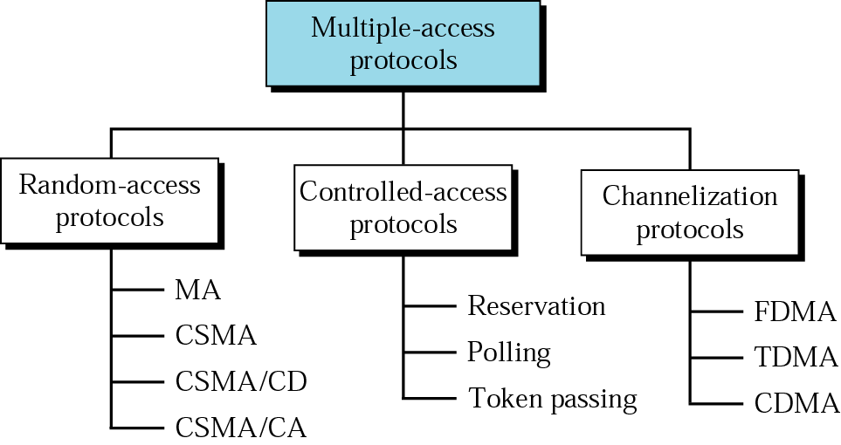
Multiple Access Protocols
ALOHA

Slide 5
RANDOM ACCESS
In random access or contention methods, no station is superior to another station and none is assigned the control over another. No station permits, or does not permit, another station to send. At each instance, a station that has data to send uses a procedure defined by the protocol to make a decision on whether or not to send.
Topics discussed in this section:
ALOHA
Carrier Sense Multiple Access
Carrier Sense Multiple Access with Collision Detection
Carrier Sense Multiple Access with Collision Avoidance

Slide 6
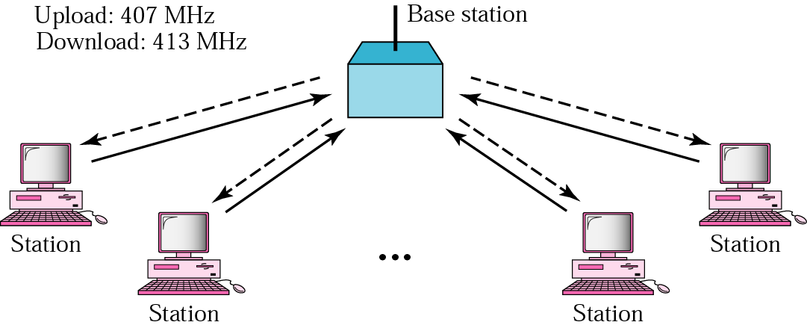
ALOHA network
Developed by Norm Abramson at the Univ. of Hawaii
  in early 1970
  the guy had interest in surfing and packet switching
  mountainous islands → land-based network difficult to install
ACK
ACK
ACK
ACK

Slide 7

Frames in a pure ALOHA network

Slide 8

Procedure for pure ALOHA protocol

Slide 9
Example 12.1
The stations on a wireless ALOHA network are a maximum of 600 km apart. If we assume that signals propagate at 3 × 10⁸ m/s, we find
Tp = (600 × 10⁵ ) / (3 × 10⁸ ) = 2 ms.
Now we can find the value of T_{B} for different values of
K .
a. For K = 1, the range is {0, 1}. The station needs to
generate a random number with a value of 0 or 1. This
means that T_{B} is either 0 ms (0 × 2) or 2 ms (1 × 2),
based on the outcome of the random variable.

Slide 10
Example 12.1 (continued)
b. For K = 2, the range is {0, 1, 2, 3}. This means that T_{B}
can be 0, 2, 4, or 6 ms, based on the outcome of the
random variable.
c. For K = 3, the range is {0, 1, 2, 3, 4, 5, 6, 7}. This
means that T_{B} can be 0, 2, 4, . . . , 14 ms, based on the
outcome of the random variable.

Slide 11

Vulnerable time for pure ALOHA protocol

Slide 12
Example 12.2
A pure ALOHA network transmits 200-bit frames on a shared channel of 200 kbps. What is the requirement to make this frame collision-free?
Solution
(frame time=frame length/bit rate)
Average frame transmission time T_{fr} is 200 bits/200 kbps or 1 ms. The vulnerable time is 2 × 1 ms = 2 ms. This means no station should send later than 1 ms before this station starts transmission and no station should start sending during the one 1-ms period that this station is sending.

Slide 13

Note
Let us G is the average number of frames generated by the system during one frame transmission time. And S is the successful transmission for pure ALOHA then
The throughput for pure ALOHA is
S = G × e ^{−2G}
The maximum throughput
S_{max} = 0.184 when G= (1/2).

Slide 14
Example 12.3
A pure ALOHA network transmits 200-bit frames on a shared channel of 200 kbps. What is the throughput if the system (all stations together) produces
a. 1000 frames per second b. 500 frames per second
c. 250 frames per second.
Solution
The frame transmission time is 200/200 kbps or 1 ms.
a. If the system creates 1000 frames per second, this is 1
frame per millisecond. The load is 1. In this case
S = G× e^{−2 G} or S = 0.135 (13.5 percent). This means
that the throughput is 1000 × 0.135 = 135 frames. Only
135 frames out of 1000 will probably survive.

Slide 15
Example 12.3 (continued)
b. If the system creates 500 frames per second, this is
(1/2) frame per millisecond. The load is (1/2). In this
case S = G × e ^{−2G} or S = 0.184 (18.4 percent). This
means that the throughput is 500 × 0.184 = 92 and that
only 92 frames out of 500 will probably survive. Note
that this is the maximum throughput case,
percentagewise.
c. If the system creates 250 frames per second, this is (1/4)
frame per millisecond. The load is (1/4). In this case
S = G × e −^{2G} or S = 0.152 (15.2 percent). This means
that the throughput is 250 × 0.152 = 38. Only 38
frames out of 250 will probably survive.

Slide 16
Slotted ALOHA
doubling the capacity of the ALOHA system
time divided into discrete intervals
  1 interval → 1 frame
the sending station waits until the beginning of the next discrete interval

Slide 17

Figure 12.6 Frames in a slotted ALOHA network

Slide 18

Figure 12.7 Vulnerable time for slotted ALOHA protocol

Slide 19
Note
Let us G is the average number of frames generated by the system during one frame transmission time. And S is the successful transmission for pure ALOHA then
The throughput for slotted ALOHA is
S = G × e^{−G} .
The maximum throughput
S_{max} = 0.368 when G = 1.

Slide 20
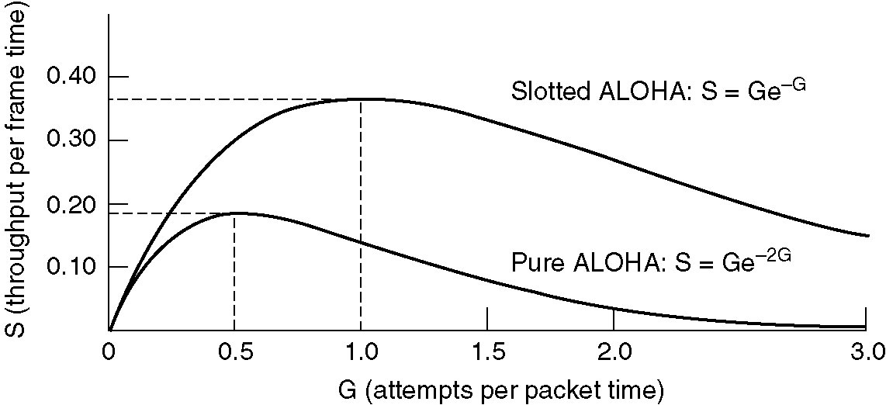
maximum efficiency: 1/e
maximum efficiency: 1/2e
Throughput versus offered traffic for ALOHA network
G - mean of the Poisson prob. of k transmission attempts per frame time

Slide 21
Example 12.4
A slotted ALOHA network transmits 200-bit frames on a shared channel of 200 kbps. What is the throughput if the system (all stations together) produces
a. 1000 frames per second b. 500 frames per second
c. 250 frames per second.
Solution
The frame transmission time is 200/200 kbps or 1 ms.
a. If the system creates 1000 frames per second, this is 1
frame per millisecond. The load is 1. In this case
S = G× e^{−G} or S = 0.368 (36.8 percent). This means
that the throughput is 1000 × 0.0368 = 368 frames.
Only 386 frames out of 1000 will probably survive.

Slide 22
Example 12.4 (continued)
b. If the system creates 500 frames per second, this is
(1/2) frame per millisecond. The load is (1/2). In this
case S = G × e^{−G} or S = 0.303 (30.3 percent). This
means that the throughput is 500 × 0.0303 = 151.
Only 151 frames out of 500 will probably survive.
c. If the system creates 250 frames per second, this is (1/4)
frame per millisecond. The load is (1/4). In this case
S = G × e ^{−G} or S = 0.195 (19.5 percent). This means
that the throughput is 250 × 0.195 = 49. Only 49
frames out of 250 will probably survive.

Slide 23
Carrier Sense Multiple Access (CSMA)
Invented to minimize collisions and increase the performance
A station now “follows” the activity of other stations
Simple rules for a polite human conversation
  Listen before talking
  If someone else begins talking at the same time as you, stop talking
CSMA:
  A node should not send if another node is already sending
    carrier sensing
CD (collision detection):
  A node should stop transmission if there is interference
    collision detection

Slide 24
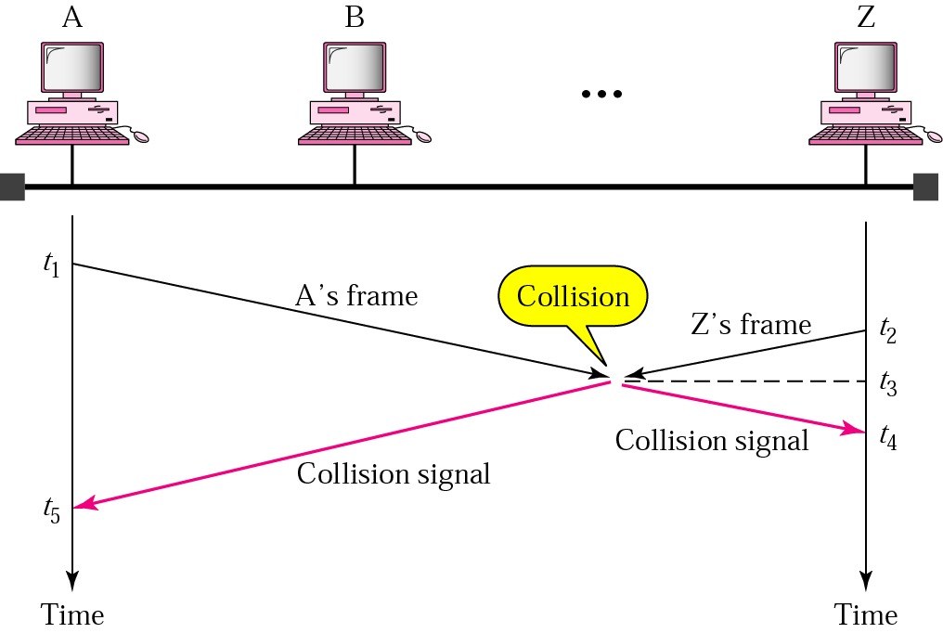
Carrier Sense Multiple Access
If everyone is sensing the medium how come that collisions still occur?
channel propagation delay

Slide 25

Space/time model of the collision in CSMA

Slide 26

Vulnerable time in CSMA

Slide 27

Behavior of three persistence methods

Slide 28

Flow diagram for three persistence methods

Slide 29

Collision of the first bit in CSMA/CD

Slide 30

Collision and abortion in CSMA/CD

Slide 31
Example 12.5
A network using CSMA/CD has a bandwidth of 10 Mbps. If the maximum propagation time (including the delays in the devices and ignoring the time needed to send a jamming signal) is 25.6 μs, what is the minimum size of the frame?
Solution
The frame transmission time is T_{fr} = 2 × T_{p} = 51.2 μs. This means, in the worst case, a station needs to transmit for a period of 51.2 μs to detect the collision. The minimum size of the frame is 10 Mbps × 51.2 μs = 512 bits or 64 bytes. This is actually the minimum size of the frame for Standard Ethernet.

Slide 32

Figure 12.14 Flow diagram for the CSMA/CD

Slide 33

Figure 12.16 Timing in CSMA/CA

Slide 34
Note
In CSMA/CA, the IFS can also be used to define the priority of a station or a frame.

Slide 35
Note
In CSMA/CA, if the station finds the channel busy, it does not restart the timer of the contention window;
it stops the timer and restarts it when the channel becomes idle.

Slide 36

Figure 12.17 Flow diagram for CSMA/CA

Slide 37
12-2 CONTROLLED ACCESS
In controlled access, the stations consult one another to find which station has the right to send. A station cannot send unless it has been authorized by other stations. We discuss three popular controlled-access methods.
Topics discussed in this section:
Reservation
Polling
Token Passing

Slide 38

Figure 12.18 Reservation access method

Slide 39

Figure 12.19 Select and poll functions in polling access method

Slide 40

Figure 12.20 Logical ring and physical topology in token-passing access method

Slide 41
12-3 CHANNELIZATION
Channelization is a multiple-access method in which the available bandwidth of a link is shared in time, frequency, or through code, between different stations. In this section, we discuss three channelization protocols.
Topics discussed in this section:
Frequency-Division Multiple Access (FDMA)
Time-Division Multiple Access (TDMA)
Code-Division Multiple Access (CDMA)

Slide 42

Figure 12.21 Frequency-division multiple access (FDMA)

Slide 43
Note
In FDMA, the available bandwidth
of the common channel is divided into bands that are separated by guard bands.

Slide 44

Figure 12.22 Time-division multiple access (TDMA)

Slide 45
Note
In TDMA, the bandwidth is just one channel that is timeshared between different stations.

Slide 46
Note
In CDMA, one channel carries all transmissions simultaneously.

Slide 47

Figure 12.23 Simple idea of communication with code

Slide 48
Figure 12.24 Chip sequences

Slide 49
Figure 12.25 Data representation in CDMA

Slide 50

Figure 12.26 Sharing channel in CDMA

Slide 51

Figure 12.27 Digital signal created by four stations in CDMA

